Slide 1
CSE101-Lec#17
Arrays
(Arrays and Functions)

Slide 2
Outline
To declare an array
To initialize an array
To pass an array to a function

Slide 3

Introduction
Arrays
  Collection of related data items of same data type.
  Static entity – i.e. they remain the same size throughout program execution

Slide 4
Arrays
Name of array (Note that all elements of this array have the same name, c)
Array
  Group of consecutive memory locations
  Same name and data type
To refer to an element, specify:
  Array name
  Position number in square brackets([])
Format:
    arrayname[position_number]
  First element is always at position 0
  Eg. n element array named c:
    c[0], c[1]...c[n – 1]
c[0]
-45
c[1]
6
c[2]
0
c[3]
72
c[4]
3
c[5]
-89
c[6]
0
c[7]
62
c[8]
-3
c[9]
1
c[10]
6453
c[11]
78
Position number of the element within array c

Slide 5
Arrays
An array is an ordered list of values
The entire array
has a single name
Each value has a numeric index
c[0] c[1] c[2] c[3] c[4] c[5] c[6] c[7] c[8] c[9]
c
79 87 94 82 67 98 87 81 74 91
An array of size N is indexed from zero to N-1
This array holds 10 values that are indexed from 0 to 9
Notes:
This will allocate 10*2 bytes of space in memory

Slide 6
Arrays
Array elements are like normal variables
    c[0] = 3;/*stores 3 to c[0] element*/
    scanf (“%d”, &c[1]);/*reads c[1] element*/
    printf (“%d, %d”, c[0], c[1]); /*displays c[0] & c[1] element*/
The position number inside square brackets is called subscript/index.
Subscript must be integer or an integer expression
    c[5 - 2] = 7; (i.e. c[3] = 7)

Slide 7
Defining Arrays
When defining arrays, specify:
  Name
  Data Type of array
  Number of elements
    datatype arrayName[numberOfElements];
  Examples:
    int students[10];
    float myArray[3284];
Defining multiple arrays of same data type
  Format is similar to regular variables
  Example:
    int b[100], x[27];

Slide 8
Initializing Arrays
Initializers
    int n[5] = { 1, 2, 3, 4, 5 };
  If not enough initializers given, then rightmost elements become 0
  int n[5] = { 0 }; // initialize all elements to 0
  C arrays have no bounds checking.
If size is omitted, initializers determine it
    int n[] = { 1, 2, 3, 4, 5 };
  5 initializers, therefore 5 element array.

Slide 9
Initializing Arrays
Array is same as the variable can prompt for value from the user at run time.
Array is a group of elements so we use for loop to get the values of every element instead of getting single value at a time.
Example: int array[5], i; // array of size 5
for(i=0;i<5;i++){// loop begins from 0 to 4
scanf(“%d”, &array[i]);
}

Slide 10
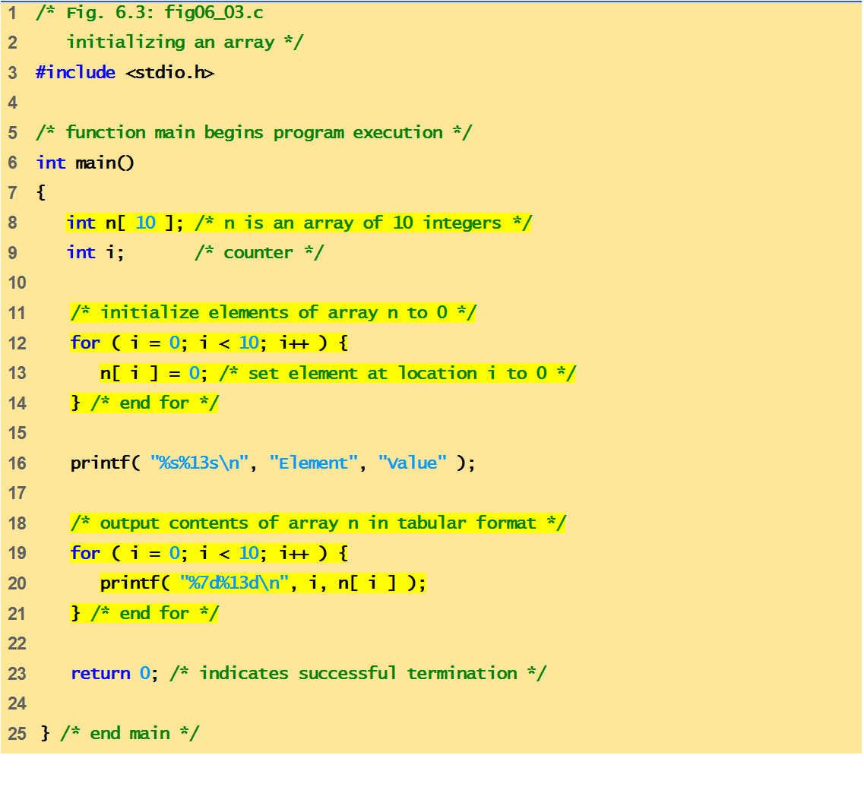
Program of Initializing an array to zero using loop.

Slide 11

Element Value
0 0
1 0
2 0
3 0
4 0
5 0
6 0
7 0
8 0
9 0
Quick yak:
Discussion can be quickly done on
%s%13s
%7d%13d
Used in the program
0
n[0]
n[1]
0
n[2]
0
n[3]
0
n[4]
0
n[5]
0
n[6]
0
n[7]
0
n[8]
0
n[9]
0

Slide 12
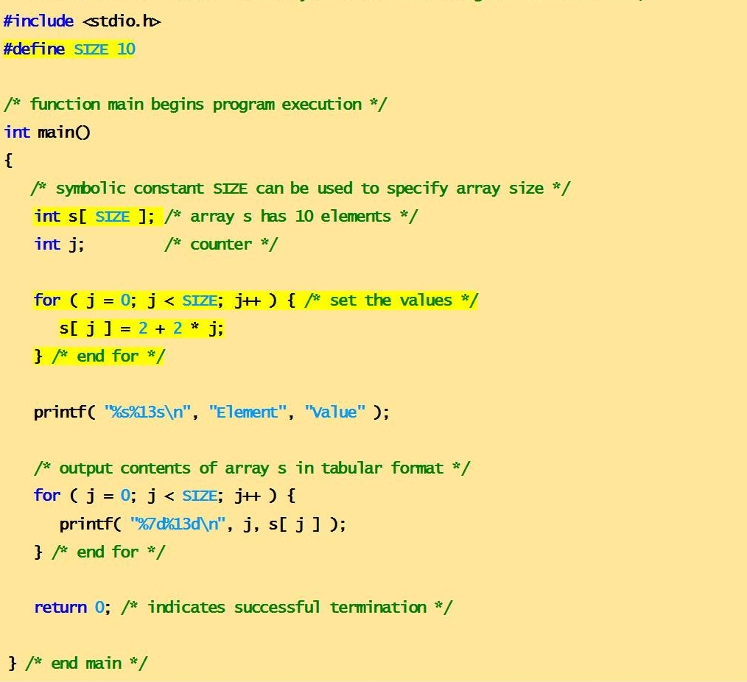
Program of Initializing an array element with calculations using loop.

Slide 13
Element Value
0 2
1 4
2 6
3 8
4 10
5 12
6 14
7 16
8 18
9 20
n[0]
2
n[1]
4
n[2]
6
n[3]
8
n[4]
10
n[5]
12
n[6]
14
n[7]
16
n[8]
18
n[9]
20

Slide 14
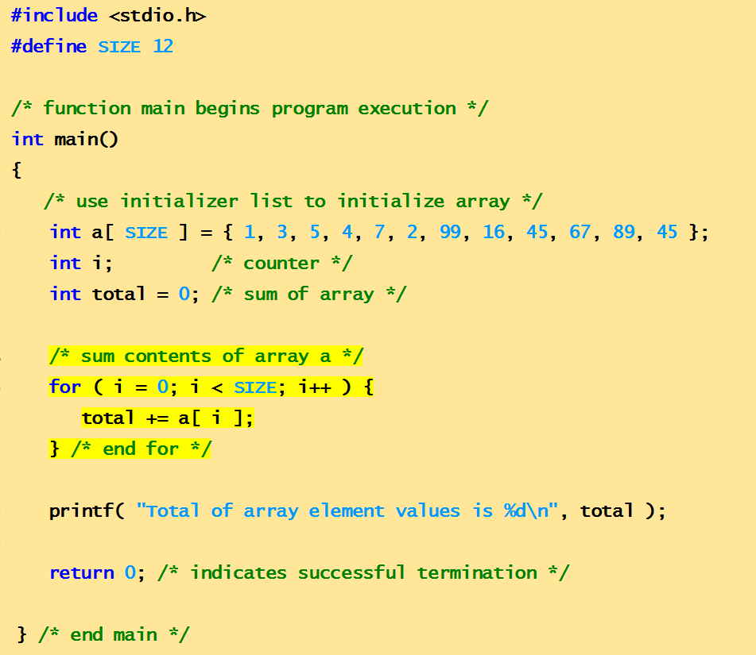
Program to compute sum of elements of array
Total of array element values is 383

Slide 15
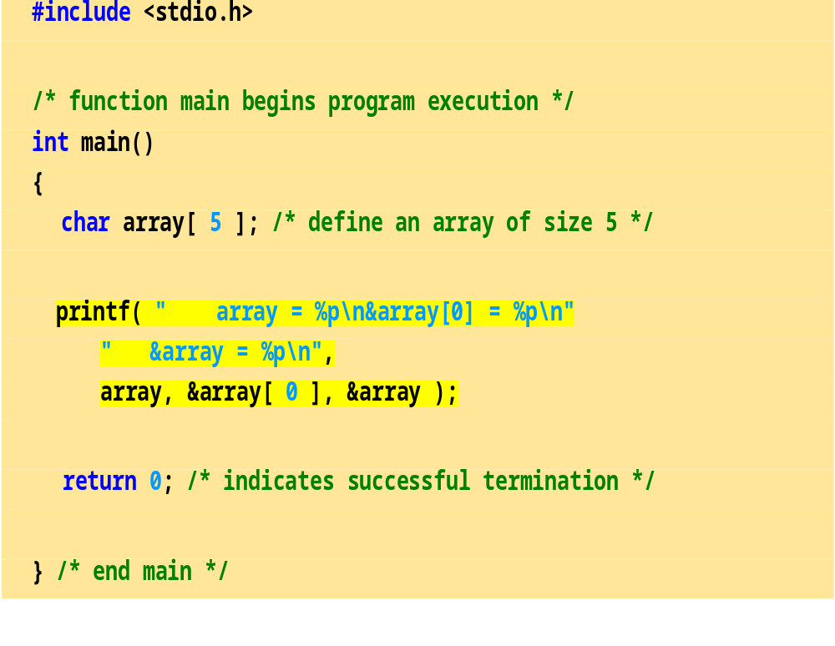
Program to explain the address of array
array = 0012FF78
&array[0] = 0012FF78
&array = 0012FF78

Slide 16
Character Arrays
Character arrays
  Character arrays can be initialized using string literals
  char string1[] = "first";
      It is equivalent to
  char string1[] = { 'f', 'i', 'r', 's', 't', '\0' };
    Null character '\0' terminates strings
    string1 actually has 6 elements
  Can access individual characters
    string1[ 3 ] is character ‘s’
  Array name is address of array, so & not needed for scanf
      scanf( "%s", string2 );
    Reads characters until whitespace encountered

Slide 17
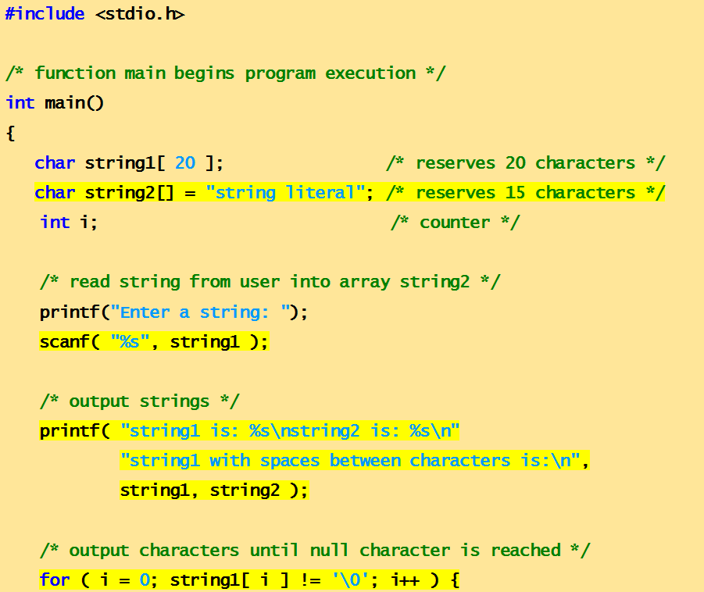
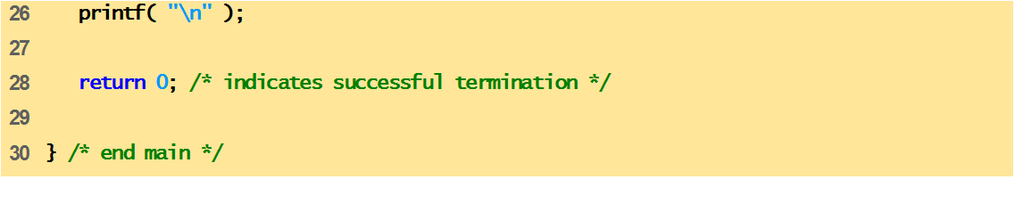
Program to print character array as strings.
,

Slide 18
Enter a string: Hello
string1 is: Hello
string2 is: string literal

Slide 19
Passing Arrays to Function
Arrays can be passed to functions in two ways:
Pass entire array
Pass array element by element

Slide 20
Pass entire array
Here entire array can be passed as an argument to the function
Function gets complete access to the original array
While passing entire array Address of first element is passed to function, any changes made inside function, directly affects the Original value.
void modifyArray(int b[], int arraySize);
Function passing method: “ Pass by Address”

Slide 21
Pass array element by element
Here individual elements are passed to the function as argument
Duplicate carbon copy of Original variable is passed to function
So any changes made inside function does not affects the original value
Function doesn’t get complete access to the original array element.
void modifyElement(int e);
Function passing method: “ Pass by Value”

Slide 22
Passing Arrays to Functions
Function prototype
void modifyArray(int b[], int arraySize);
  Parameter names optional in prototype
    int b[] could be written int []
    int arraySize could be simply int
  void modifyArray(int [], int);
Function call
int a[SIZE];
modifyArray(a, SIZE);

Slide 23
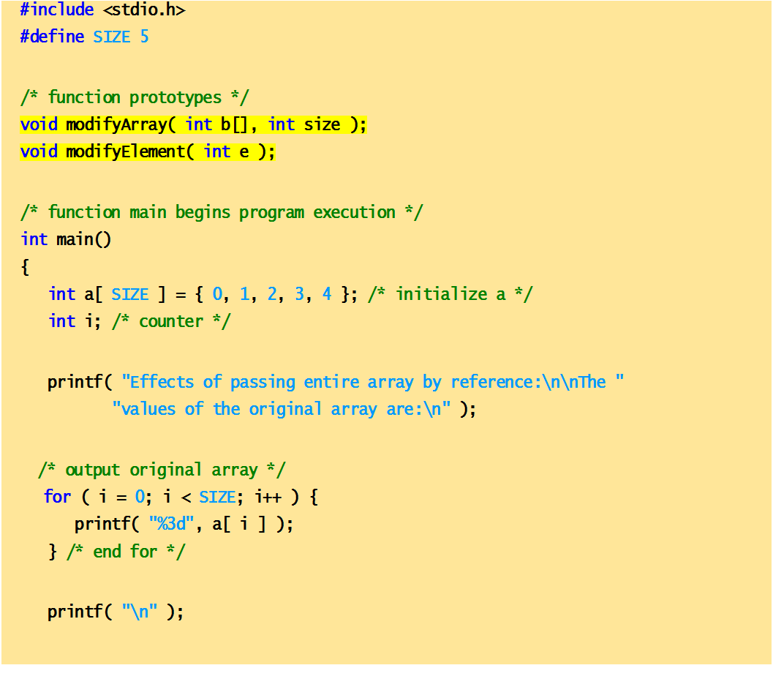
Passing arrays and individual array elements to functions

Slide 24
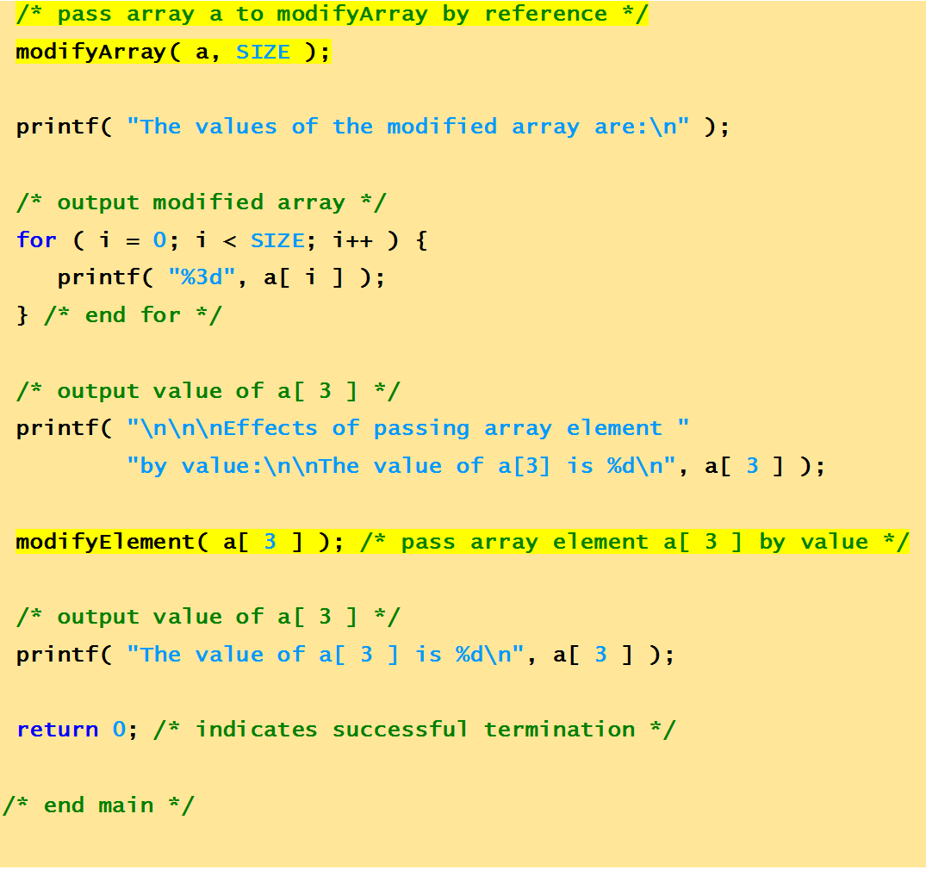

Slide 25
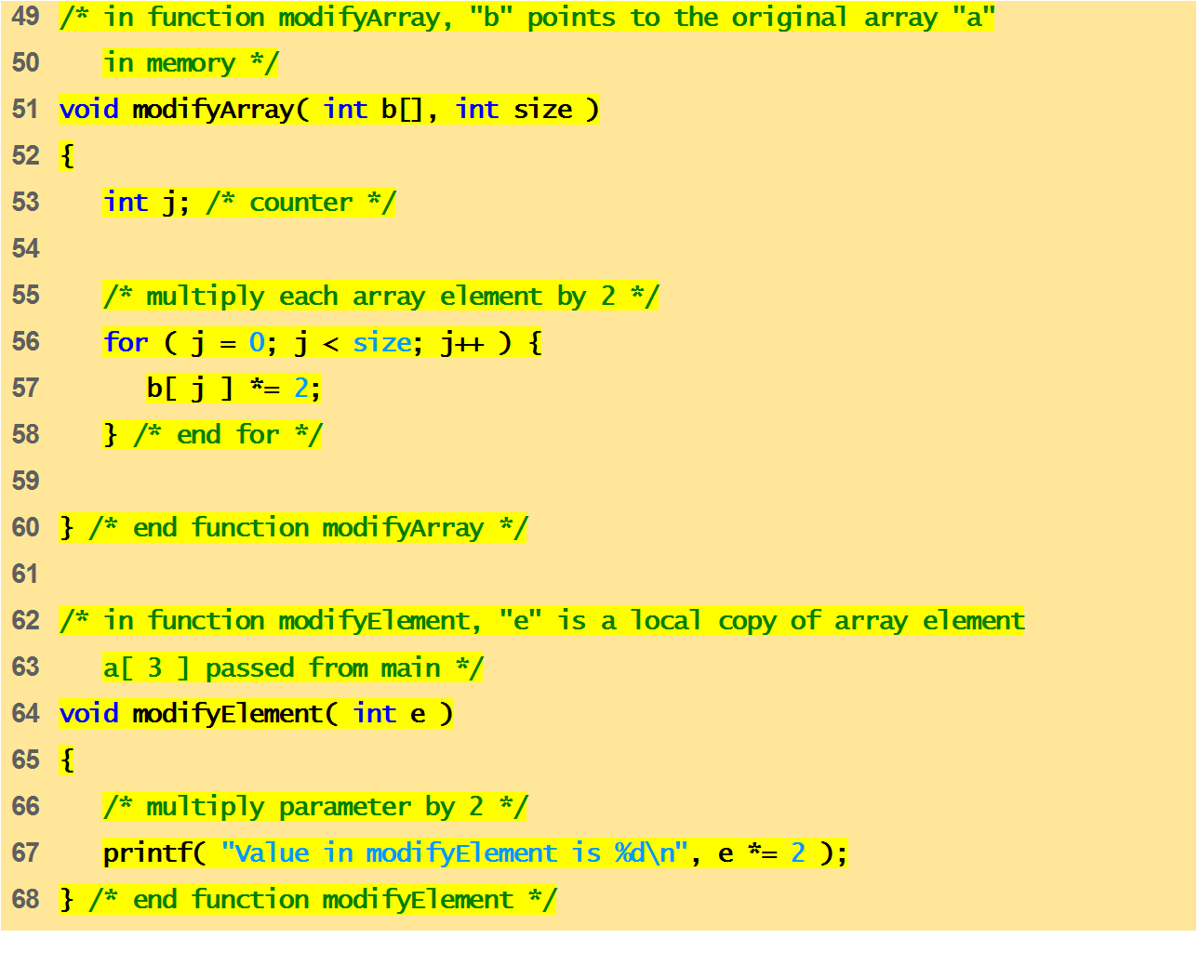

Slide 26
Effects of passing entire array by reference:
The values of the original array are:
0 1 2 3 4
The values of the modified array are:
0 2 4 6 8
Effects of passing array element by value:
The value of a[3] is 6
Value in modifyElement is 12
The value of a[3] is 6

Slide 27
MCQ
Choose a correct statement about C language arrays.
A) An array address is the address of first element of array itself.
B) An array size must be declared if not initialized immediately.
C) Array size is the sum of sizes of all elements of the array.
D) All the above

Slide 28
MCQ
What is the output of C Program.?
int main()
{
int a[] = {1,2,3,4};
int b[4] = {5,6,7,8};
printf("%d,%d", a[0], b[0]);
}
A) 1,5
B) 2,6
C) 0 0
D) Compiler error

Slide 29
MCQ
What is the output of C Program.?
int main()
{
int a[3] = {10,12,14};
a[1]=20;
int i=0;
while(i<3)
{
printf("%d ", a[i]); i++; }
}
A) 20 12 14
B) 10 20 14
C) 10 12 20
D) Compiler error

Slide 30
MCQ
An array Index starts with.?
A) -1
B) 0
C) 1
D) 2

Slide 31
What is the minimum and maximum Indexes of this below array.?
int main()
{
int ary[9];
return 0;
}
A) -1, 8
B) 0, 8
C) 1,9
D) None of the above

Slide 32
MCQ
Array can be considered as set of elements stored in consecutive memory locations but having __________.
A. Same data type
B. Different data type
C. Same scope
D. None of these

Slide 33
What is a multidimensional array in C Language.?
A) It is like a matrix or table with rows and columns
B) It is an array of arrays
C) To access 3rd tow 2nd element use ary[2][1] as the index starts from 0 row or column
D) All the above.

Slide 34
Find the output of the code?
#include <stdio.h>
void main()
{
int a[2][3] = {1, 2, 3, 4, 5};
int i = 0, j = 0;
for (i = 0; i < 2; i++)
{
for (j = 0; j < 3; j++)
printf("%d", a[i][j]);
}
}
a) 1 2 3 4 5 0 b) 1 2 3 4 5 junk c) 1 2 3 4 5 5 d) Run time error

Slide 35
MCQ
Size of the array need not be specified, when
A.Initialization is a part of definition
B.It is a declaratrion
C.It is a formal parameter
D.All of these

Slide 36
MCQ
Consider the array definition
int num [10] = {3, 3, 3};
Pick the Correct answers
A.num [9] is the last element of the array num
B.The value of num [ 8] is 3
C.The value of num [ 3 ] is 3
D.None of the above

Slide 37
MCQ
Which of the following statements are correct about 6 used in the program?
int num[6];
num[6]=21;
A.In the first statement 6 specifies a particular element, whereas in the second statement it specifies a type.
B.In the first statement 6 specifies a array size, whereas in the second statement it specifies a particular element of array.
C.In the first statement 6 specifies a particular element, whereas in the second statement it specifies a array size.
D.In both the statement 6 specifies array size.

Slide 38
Point the correct statement
An array element may be an array by itself
Strictly speaking C supports 1-dimensional arrays only
Array elements need not occupy contiguous memory locations

Slide 39
MCQ
Where is linear searching used?
a) When the list has only a few elements
b) When performing a single search in an unordered list
c) Used all the time
d) When the list has only a few elements and When performing a single search in an unordered list

Slide 40
Next Class:
Applications of Arrays

